Slide 1
Streaming Wars:
A Data-Driven Story of Content Diversity
CS_3820 Midterm Project
BY: TOLSON LYMAN

Slide 2
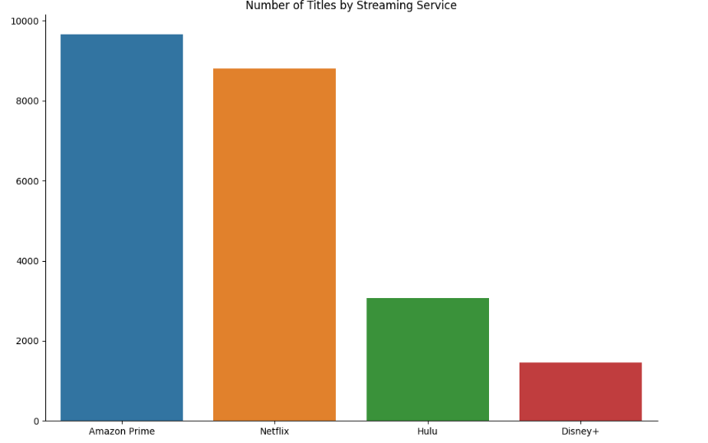
BAR CHART
This difference in volume highlights the strategic divergence between platforms: while Netflix and Amazon Prime focus on offering a broad variety, Disney+ and Hulu emphasize depth within specific content niches.
80
78
60
50
40
30
20
10
BAR GRAPH INFO 1
BAR GRAPH INFO 1
BAR GRAPH INFO 1
BAR GRAPH INFO 1

Slide 3
Leads the market with the largest library.
Aggressive content acquisition and production strategy.
Amazon Prime
Netflix
Follows closely
Diverse catalog, including movies, series, and exclusive productions.
Hulu
Smaller libraries, focus on niche audiences
Emphasis on TV series
Disney+
Smaller libraries, focus on niche audiences
Family-friendly and franchise-driven content.
Total Titles by Platform

Slide 4
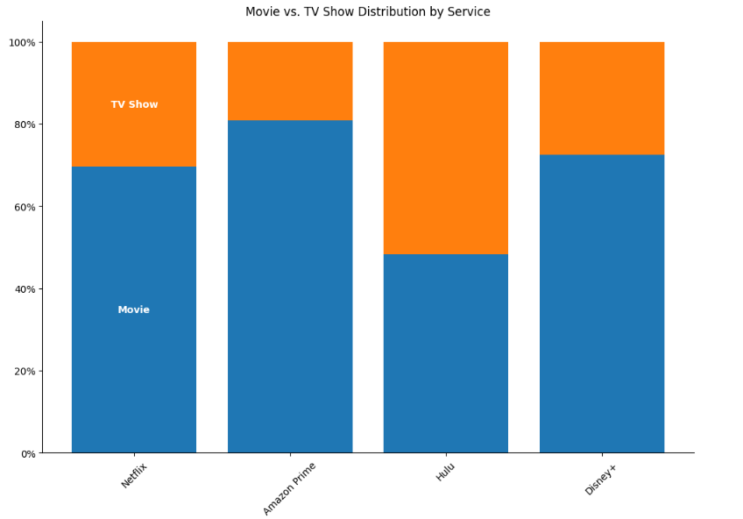
100% STACKED BAR PLOT
This distribution highlights how each platform tailors its content offerings to cater to distinct viewer preferences.

Slide 5
Distribution of Movies and TV Shows Across Platforms
This analysis reveals how each service prioritizes different content types
Netflix
Amazon Prime
Offers a balanced mix of movies and TV shows, with a slight emphasis on TV series, supporting its strategy of producing binge-worthy original series.
Leans heavily toward movies, offering a vast catalog of films spanning various genres and periods.
Hulu
Disney+
Focuses predominantly on TV shows, making it a go-to platform for viewers who enjoy serialized content.
Primarily emphasizes movies, driven by its extensive collection of blockbuster franchises like Marvel, Star Wars, and animated classics.

Slide 6
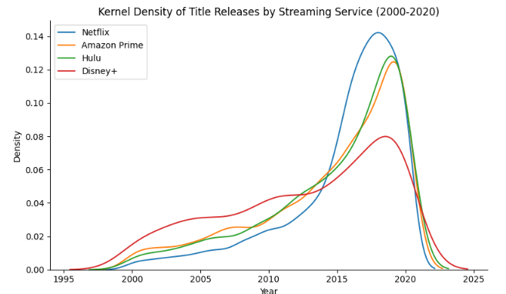
HISTOGRAM (DENSITY PLOT)
Analyzing the release trends over time provides insights into content production growth
80
78
60
50
40
30
20
10
BAR GRAPH INFO 1
BAR GRAPH INFO 1
BAR GRAPH INFO 1
BAR GRAPH INFO 1

Slide 7




Netflix
Prime Video
Hulu
Disney+
Has consistently increased its content output, peaking around 2018-2020, driven by its push for global market dominance.
Follows a steady growth pattern but at a slower pace than Netflix.
Maintains a stable release schedule, focusing on selective, high-quality productions.
Exhibits a rapid rise in content after its 2019 launch, driven by leveraging its strong intellectual property.

Slide 8
CONCLUSION
The data tells a clear story of strategic divergence. Netflix’s massive, diverse library caters to global audiences with broad interests, while Disney+ focuses on depth within its franchise-driven content. Hulu prioritizes high-quality TV shows, and Amazon Prime balances between documentaries and feature films. These trends highlight how each platform differentiates itself in a crowded market, carving out distinct niches to capture viewer loyalty.
As competition intensifies, understanding these content strategies will be crucial for predicting future developments in the streaming landscape.

